Slide 1


Failure Detection for
Pharmaceutical Cold Chain Logistics
Client
Advisor
Ashish Pujari
Presented By
Amily Huang
Jenny Jiang
Duo Zhou

Slide 2
Problem Statement
Reducing the failed shipment ratio is a long-sought objective for pharmaceutical cold chain industry
Find solutions that can ultimately help to predict and mitigate failures during a shipment
“Pharmaceutical manufacturers lose 15 billion per year due to cold chain failure”
3

Slide 3

What is a safe delivery of shipment?
01
Pharmaceuticals do not experience temperature deviation
02
Container has no critical parts failure
03
Container is performing according to design
2

Slide 4


Goal of Analysis
Predictive Model
Predict the likelihood of temperature deviation given certain order information
Help the company to give pin-pointed handling instructions, or reconsider flight routes for a shipment when a prediction of high likelihood of failure is given
Failure Risk Profile
Identify failure root causes to different types of failures
SAFE
Identify major container handling behaviors that lead to high failure rate
Understand the circumstances when failure happens
4
Notes:
Standardize and improve training process to lower improper handling related failure and reduce cost
Identify top airlines and trade lanes that have high failure rate

Slide 5
Data Overview
Container Logged Data
Trade lane &
Shipment Data
Jan 2018 - Feb 2021
Integrated using container number and order number
Each observation contains information regarding a unique container movement from origin to destination
Container movement for 3 years
Reported Incidents
Data
Supplementary
Data
70k+
5

Slide 6
Analytics Workflow
SAFE
Data Preparation
Descriptive Analysis
Predictive Model
Recommendation
Failure (Label) Definition
Variable Aggregation
Row Selection
Failure Risk Profile
Colinearity Analysis
Feature Engineering
Imbalanced Data Handling
Model Implementation
Model Evaluation
6
Notes:
Anomaly = under+over

Slide 7


Failure Definition
Label
Binary: Failure (1) vs. Normal (0)
Temperature Deviation
Average container inside temperature deviates from the set temperature range
This definition of temperature deviation(TD) was validated using actual reported TD data
Parts Failure Alarms
Essential parts alarms are triggered
Compressor Performance Anomalies
Container compressor is not functioning properly
Compressor is a critical part and more frequently utilized
7
7
Data Preparation
Descriptive Analysis
Predictive Model
Recommendation
Notes:
The details of the comparison and validation are displayed in the appendix

Slide 8

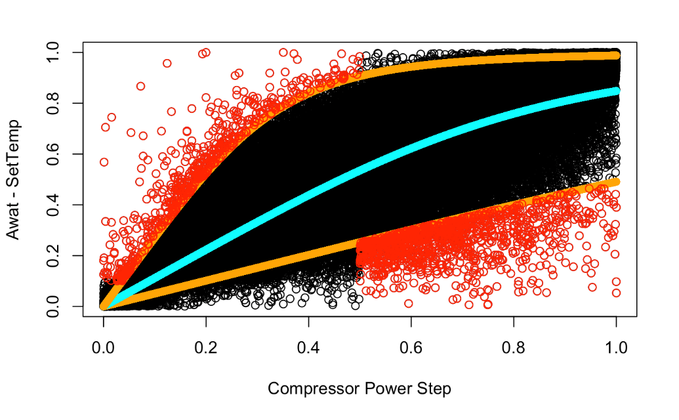

Failure Definition - Compressor Performance Anomalies
Extract 1,673 anomaly observations using Copula Quantile Regression
Distribution
Compressor Power Step vs. Delta
Method
Copula quantile regression 5% and 95%
Definition
Over-performing: Delta is low, but compressor power step is high
Under-performing: Delta is high, but compressor power step is low
Total Anomaly
1673 observations
Data Preparation
Descriptive Analysis
Predictive Model
Recommendation
8
Notes:
Delta will be discussed in next slides

Slide 9
Variable Aggregation & Row Selection
Variable Aggregation
Out of Design Temperature Exposure Duration (ODTD)
Average Weighted Ambient Temperature (AWAT)
Delta (AWAT - Set Temperature)
Row Selection
Only records with container logged information are selected
Only shipments with operational log time duration larger than 8 hours are chosen to avoid average inside temperature values being over influenced by container’s preconditioning period
Data Preparation
Descriptive Analysis
Predictive Model
Recommendation
9

Slide 10

Descriptive Analysis
10

Slide 11
Failure Risk Profile
Profile 1
Profile 2
Profile 3
Temperature Deviation (TD)
Risk Profile
Compressor Performance Anomaly Risk Profile
Failure Alarms
Risk Profile
Validation of self defined TD using reported
Compressor
Heater
Charger
Data Preparation
Predictive Model
Recommendation
11
Descriptive Analysis

Slide 12
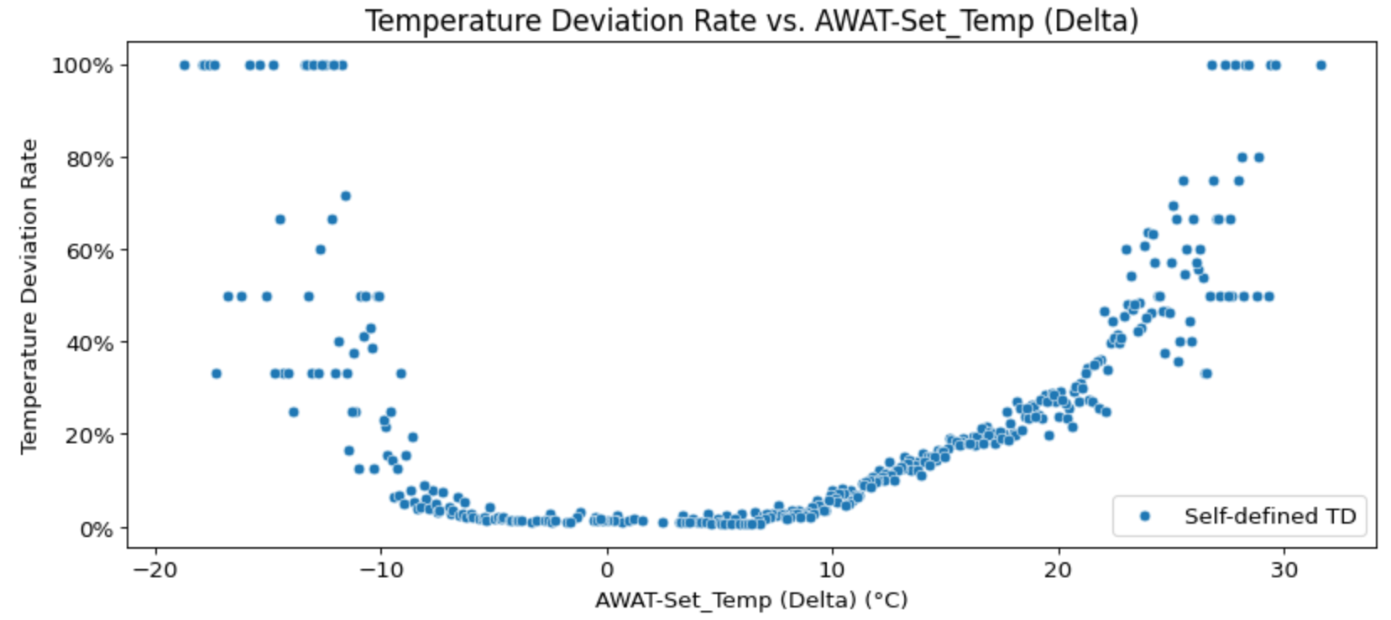
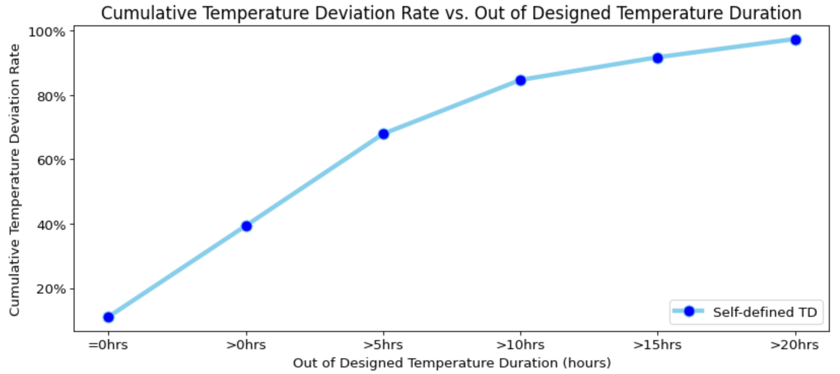
Temperature Deviation (TD) Risk Profile
Higher ambient temperature and longer exposure to extreme temperature increase TD rate
Season
Summer has the highest TD rate, taking up 39% of the total TD
Shipment Duration
The longer the shipment duration, the higher the TD rate
Delta
TD rate increases exponentially when |Delta| is above 10°C
Out of designed temperature exposure duration (ODTD)
TD rate reaches 70% when ODTD is above 5 hours
Data Preparation
Predictive Model
Recommendation
12
Descriptive Analysis

Slide 13
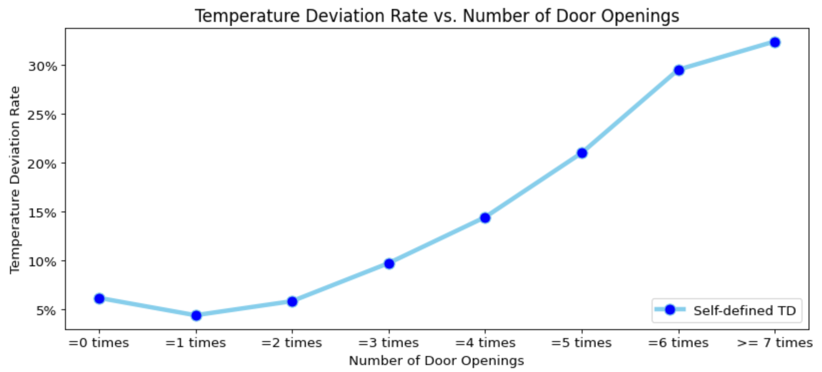
Temperature Deviation (TD) Risk Profile
More door openings and lower battery mean increase TD rate
Number of door openings
TD rate climbs after 3 times of door openings
Battery Mean
TD rate increases when battery mean is below 70%
Economic Status of origin and destination countries
TD increases when the origin is developing country
10.6%
Developed → Developed
9.6%
Developed → Developing
16.1%
Developing → Developed
17.2%
Developing → Developing
Data Preparation
Predictive Model
Recommendation
13
Descriptive Analysis

Slide 14
Failure Alarms Risk Profile
Compressor & Heater Alarms
Higher ambient temp., longer exposure to extreme temp., and more door openings increase alarm rate
Season
Summer takes up 39% of total compressor alarms and 56% of total heater alarms
Delta
Compressor alarm rate increases as Delta gets larger
A
Out of designed temperature exposure duration (ODTD)
Compressor alarm rate jumps after 4 hrs of ODTD
Heater alarm rate increases sharply after 10 hrs of ODTD
l
a
r
m
R
a
t
e
S
p
r
i
n
g
S
u
m
m
e
r
A
u
t
u
m
n
W
i
n
t
e
r
C
o
m
p
r
e
s
s
o
r
0
.
2
1
%
0
.
4
4
%
0
.
2
5
%
0
.
2
8
%
H
e
a
t
e
r
0
.
0
6
%
0
.
2
0
%
0
.
0
4
%
0
.
0
6
%
Shipment Duration
The longer the shipment duration, the higher the compressor & heater alarm rate
Number of door openings
Compressor & heater rate increases after 6 times of door openings
Data Preparation
Predictive Model
Recommendation
14
Descriptive Analysis
Notes:
Supply Voltage:
Compressor and heater alarms are more likely to occur in summer
Charger alarm rate peaks when container is exposed to a supply voltage of 100V-127V in origin and destination

Slide 15
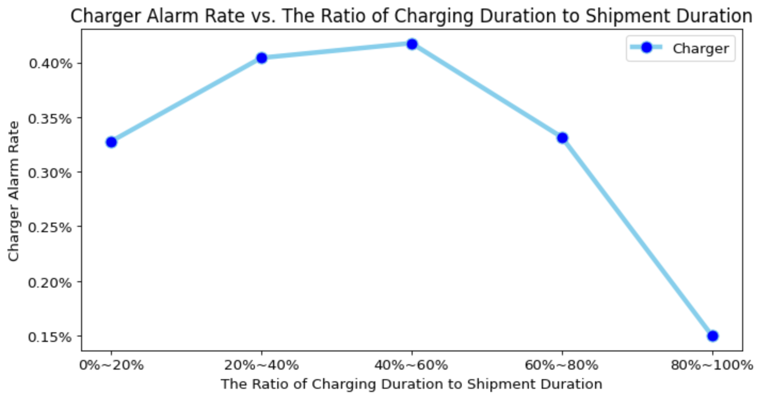
Failure Alarms Risk Profile
Charger Alarms
Supply voltage of 100V-127V and incorrect charging behavior increase charger alarm rate
Supply Voltage
Charger alarm rate peaks when the supply voltage is 100V-127V in origin and destination
Charging Behavior
Not continuously charging the container
Frequently alternating between charging and no charging
0.65%
0.32%
Origin Voltage
100V-127V
220V-240V
Destination Voltage
100V-127V
220V-240V
Data Preparation
Predictive Model
Recommendation
15
Descriptive Analysis
Notes:
Charger alarm rate doubles when the supply voltage is 100 – 127volt
Supply Voltage:
Compressor and heater alarms are more likely to occur in summer
Charger alarm rate peaks when container is exposed to a supply voltage of 100V-127V in origin and destination

Slide 16



Compressor Performance Anomalies Risk Profile
Containers with compressor performance issue tend to have more compressor alarm rate & TD rate
Compressor Alarm Rate
Temperature Deviation Rate
Out of Designed Temperature
Exposure (hrs)
Mean Battery Level
Mean Number of Door Openings
Charging Time Ratio
Normal
0.3%
13%
0.045
80%
3.5
47%
Abnormal
1.1%
35%
0.119
71%
4.4
40%
Data Preparation
Predictive Model
Recommendation
16
Descriptive Analysis

Slide 17
Predictive Model
17

Slide 18
Feature Engineering
Label Selection
Predictors Selection
Recategorization
Temperature deviation (TD)
Reason: The ultimate objective is to avoid temperature deviation during a shipment
Features whose values are given or can be estimated at the beginning of each shipment
Season
Set Temperature
Estimated Shipment Duration
Estimated AWAT
Usage
Origins and Destinations
Airlines
To avoid over dimensionalities of following categorical features
Origins and Destinations – Recategorized into 4 groups by economic status
Airlines- Recategorized into 3 groups by number of container shipments with Envirotainer
Data Preparation
Descriptive Analysis
Predictive Model
Recommendation
18

Slide 19


Imbalanced Data Handling
Main reason to create balanced dataset: Give equal priority to each class
 | Adaptive Resampling |  | Cost-sensitive learning
 | Oversampling | Down-sampling
Concept
Advantage | no loss of information | reduce run-time and memory | no loss of information
Disadvantage | prune to overfit than down-sampling | lose critical information and create bias
Random down-sampling
88%
SMOTE
:
=
7.3 : 1
12%
TD
No TD
No TD
TD
TD
No TD
No TD
TD
No TD
TD
Original Dataset
Final Dataset
Original Dataset
Final Dataset
Original Dataset
Weights for cost function
Data Preparation
Descriptive Analysis
Predictive Model
Recommendation
19

Slide 20
Model Implementation & Evaluation
Data was split into train (67.5%), validation (22.5% ), and test (10%) sets
Algorithms Implemented
Evaluation Metrics
Model Overfitting
Recall
AUC score
Logistic Regression
XGBoost
Artificial Neural Network (ANN)
Failures rarely occur but costly
It preferred to over predict failures to place extra caution and failure preventative measures
Measures how much the model is capable of distinguishing between classes
Higher the AUC score, the better the model is at predicting 0s as 0s and 1s as 1s
Data Preparation
Descriptive Analysis
Predictive Model
Recommendation
20

Slide 21
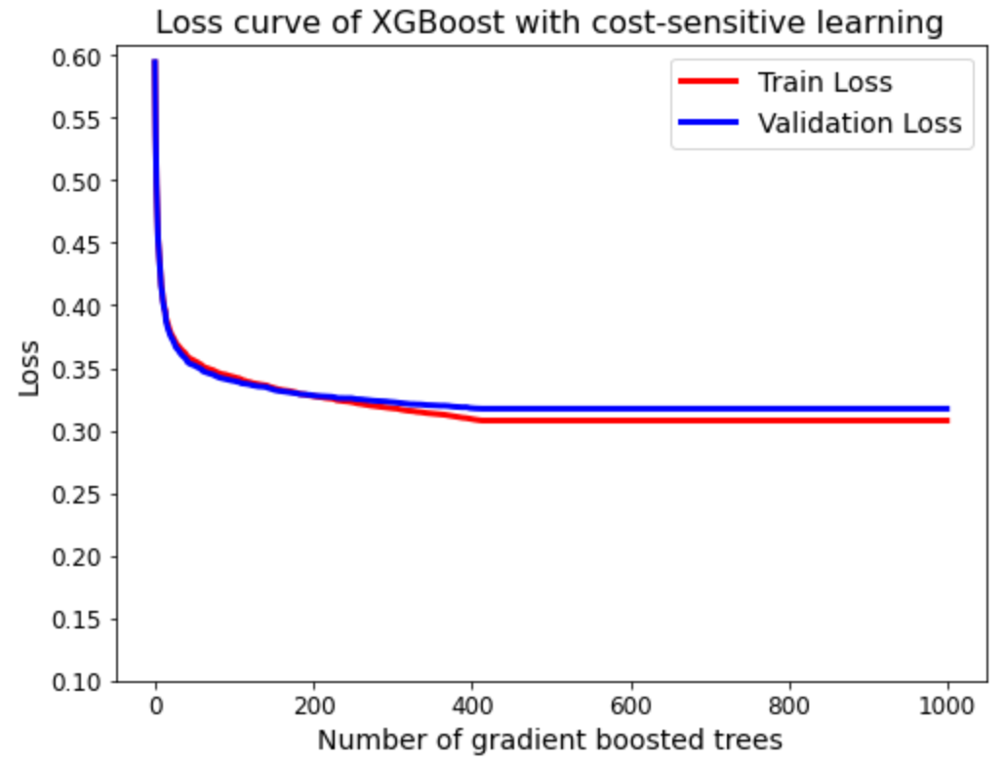
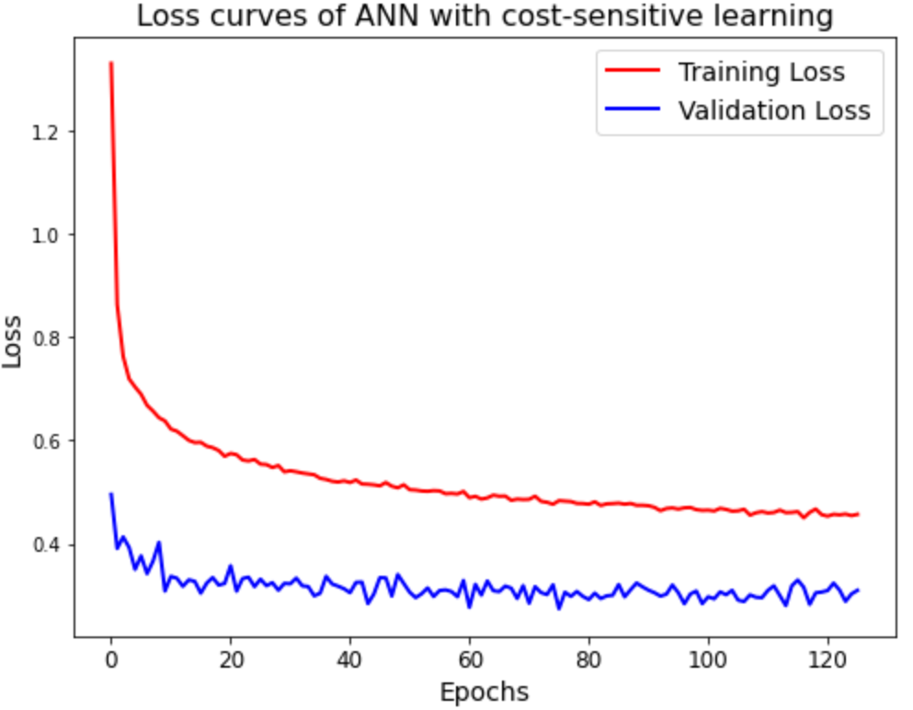
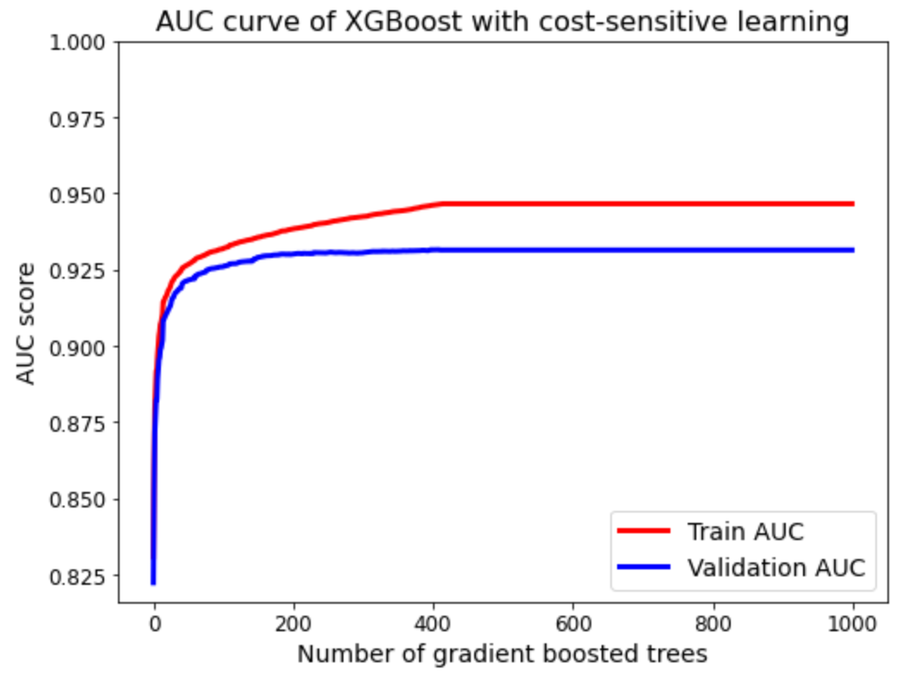
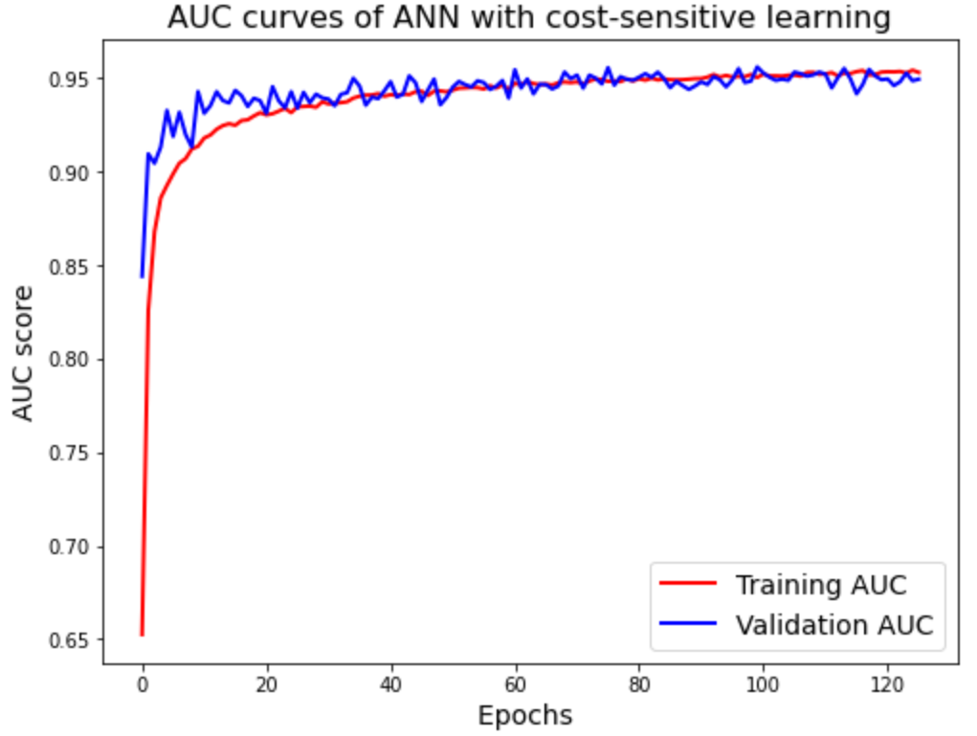
Model Implementation – Overfitting Analysis
Cost-Sensitive Learning | XGBoost | ANN
Loss Curve
AUC Curve
Training Loss
Validation Loss
Cost sensitive learning performed best for both XGBoost and ANN
However, ANN with cost-sensitive learning performed much better in the convergence progression between train and validation AUC scores than XGBoost.
Number of Gradient Boosted Trees
Epochs
Number of Gradient Boosted Trees
Epochs
Data Preparation
Descriptive Analysis
Predictive Model
Recommendation
21

Slide 22
AUC & Recall Scores
Highest Recall with Good AUC Scores
Validation set
Recall Score | Logistic Regression | XGBoost | ANN
Original data | 0.298 | 0.486 | 0.484
Oversampling with SMOTE | 0.821 | 0.590 | 0.825
Random down-sampling | 0.820 | 0.878 | 0.891
Cost sensitive learning | 0.821 | 0.878 | 0.891
Winning Model
Test Set
Accuracy: 0.8641
Precision: 0.472
Recall Score: 0.891
F1 Score: 0.61
AUC score 0.936
Artificial Neural Network with cost-sensitive learning
AUC Score | Logistic Regression | XGBoost | ANN
Original data | 0.876 | 0.931 | 0.936
Oversampling with SMOTE | 0.889 | 0.920 | 0.930
Random down-sampling | 0.887 | 0.927 | 0.928
Cost sensitive learning | 0.888 | 0.931 | 0.936
22
Data Preparation
Descriptive Analysis
Predictive Model
Recommendation
22

Slide 23
Model Interpretability
XGBoost is more interpretable that ANN
Shipment Duration and Delta (AWAT-Set Temp) have the most impact on failure occurrence.
Data Preparation
Descriptive Analysis
Predictive Model
Recommendation
23

Slide 24
Recommendation
24

Slide 25
Recommendation
01
Place containers into temperature-controlled storages during transition
02
Turn on the container no more than 2 hours before placing the product inside
03
Minimize the during a shipment, under 5 times if possible
Continuously charge and maintained the battery level above 70% if possible
04
05
Use voltage transformers when the supply voltage is between 100V - 127V or consider a charger design modification
25
Notes:
看要不要把這句刪掉, 前面charging alarm已經有說到了
do not frequently alternate between charging and not charging
這句話可以用講的~ 這樣slide也看起來更清晰

Slide 26
Demo
Step 1
Step 2
Step 3
Step 4
Predictive Model
Recommended Preventative Measures
Release Month | May
Set Temp (°C) | 5 °C
Average Ambient Temperature(°C) | 22 °C
Shipment duration | 200hrs
Origin - Destination | ATL - DEL
Airlines | Delta Air Lines (Big Airlines)
Place an Order
The classification
is TD
26

Slide 27
Future Works
01
Utilizing historical and streaming data to give real time or near real time predictions on different types of failures
02
Establishing a resource/logistic allocation system based on the derived insights on shippers, airlines, routes and transfer hubs
03
Generating real time/near real time solutions, i.e. maintenance, repair or replacement, using both real time failure prediction and resource allocation systems
04
Developing demand related analytics and forecast based on historical ordering data, order back-log data and real time health events.
25
Notes:
看要不要把這句刪掉, 前面charging alarm已經有說到了
do not frequently alternate between charging and not charging
這句話可以用講的~ 這樣slide也看起來更清晰

Slide 28
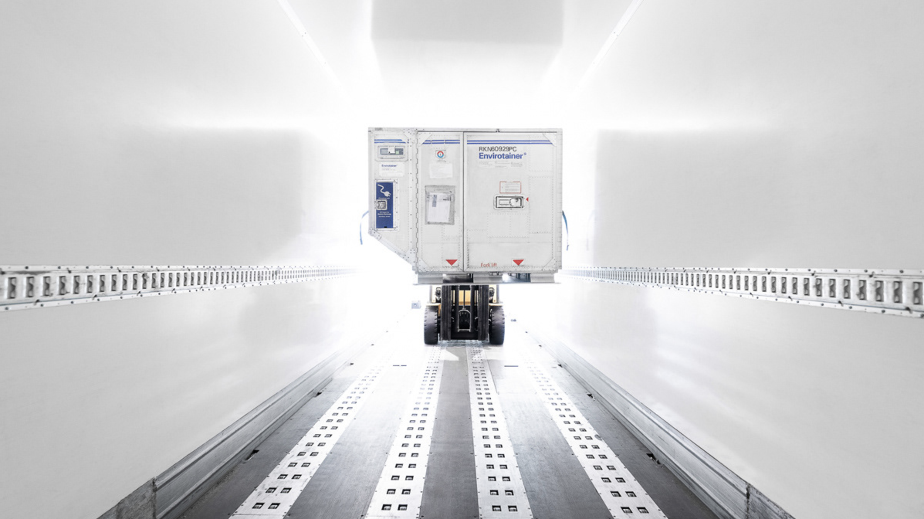
Thank You!
27

Slide 29
Appendix
28

Slide 30
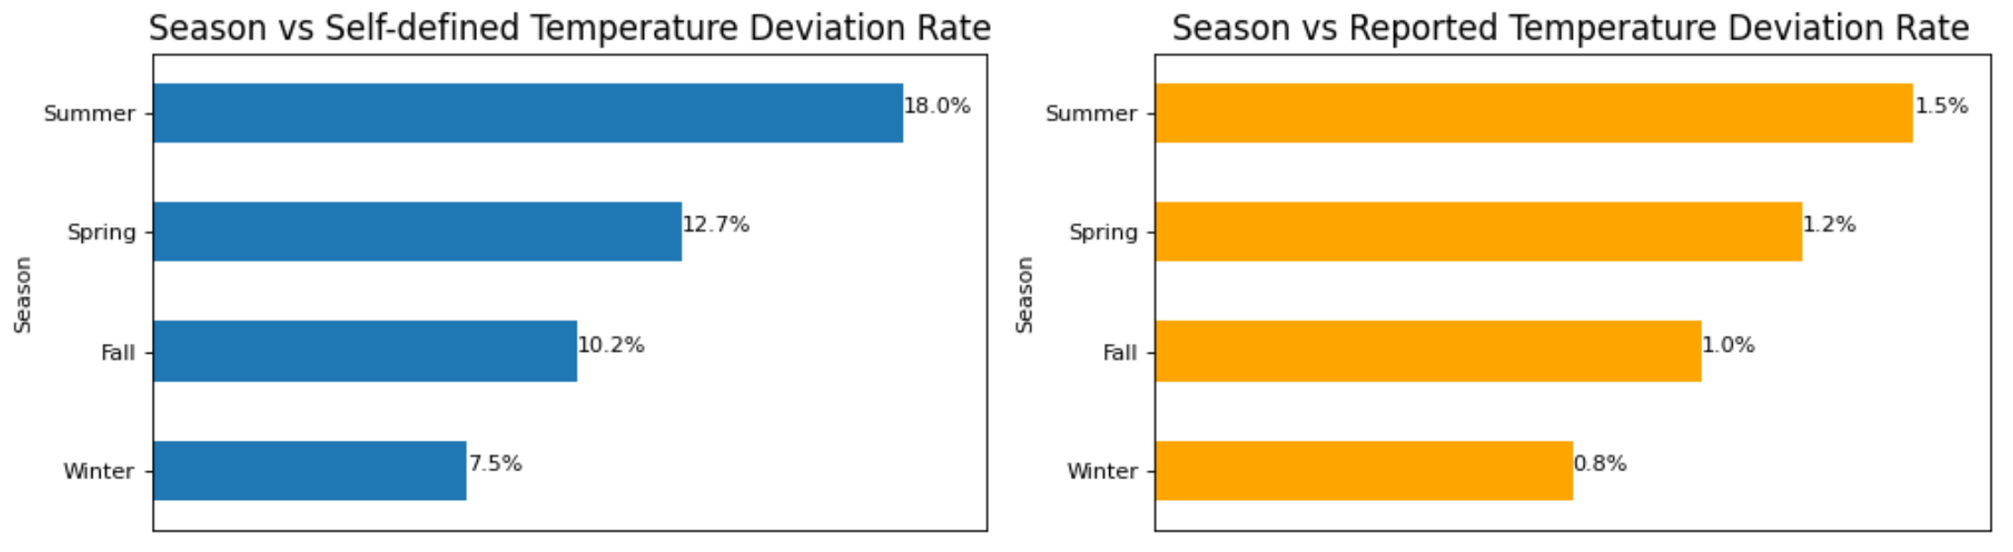
Temperature Deviation Findings
Season vs. Temperature Deviation Rate
Temperature deviation often happens in summer
Reported temperature deviations show the same trend against the season factor
29

Slide 31
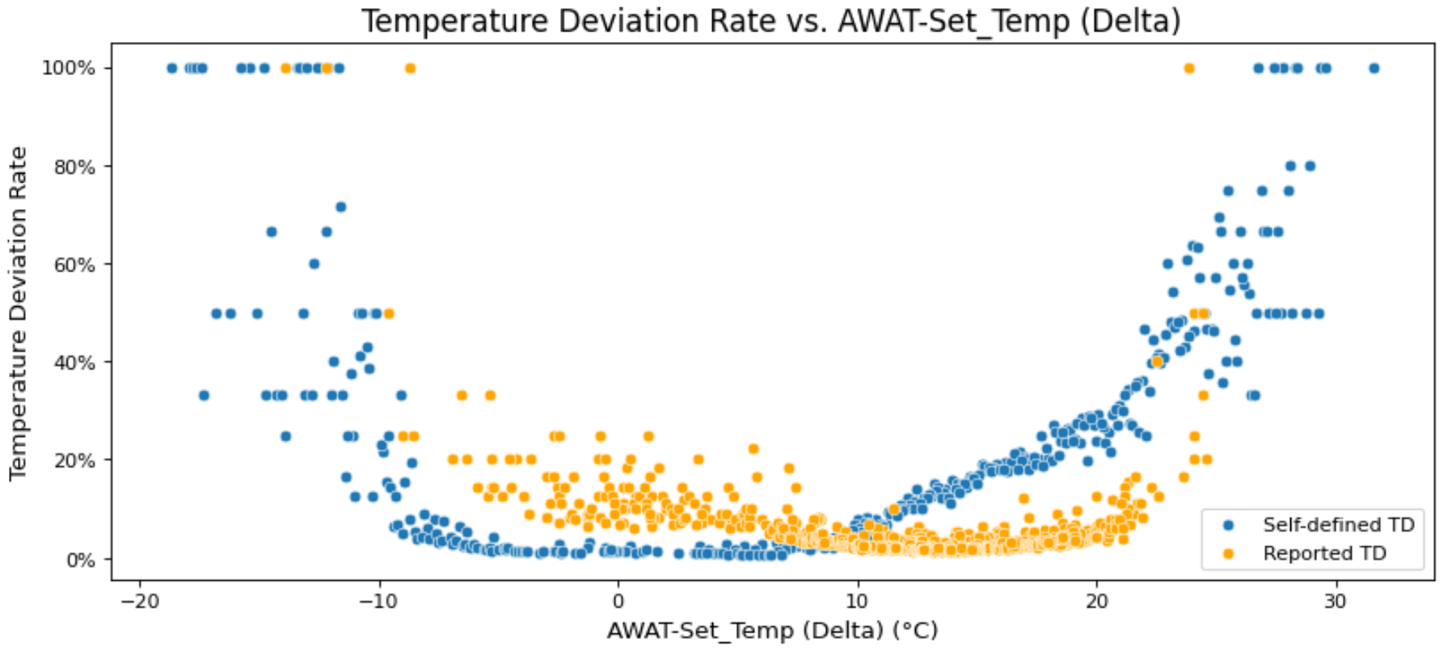
Temperature Deviation Findings
Delta vs. Temperature Deviation Rate
When the Delta is extremely high or low, the temperature deviation rate is 100%
The temperature deviation rate minimizes when Delta is between -10°C and 10°C and starts to exponentially increase when Delta is over 10°C or below -10°C.
30

Slide 32
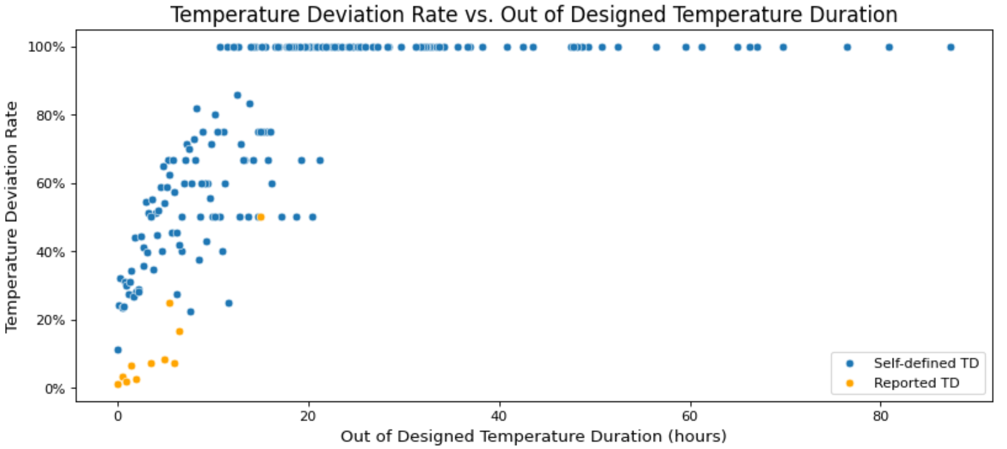
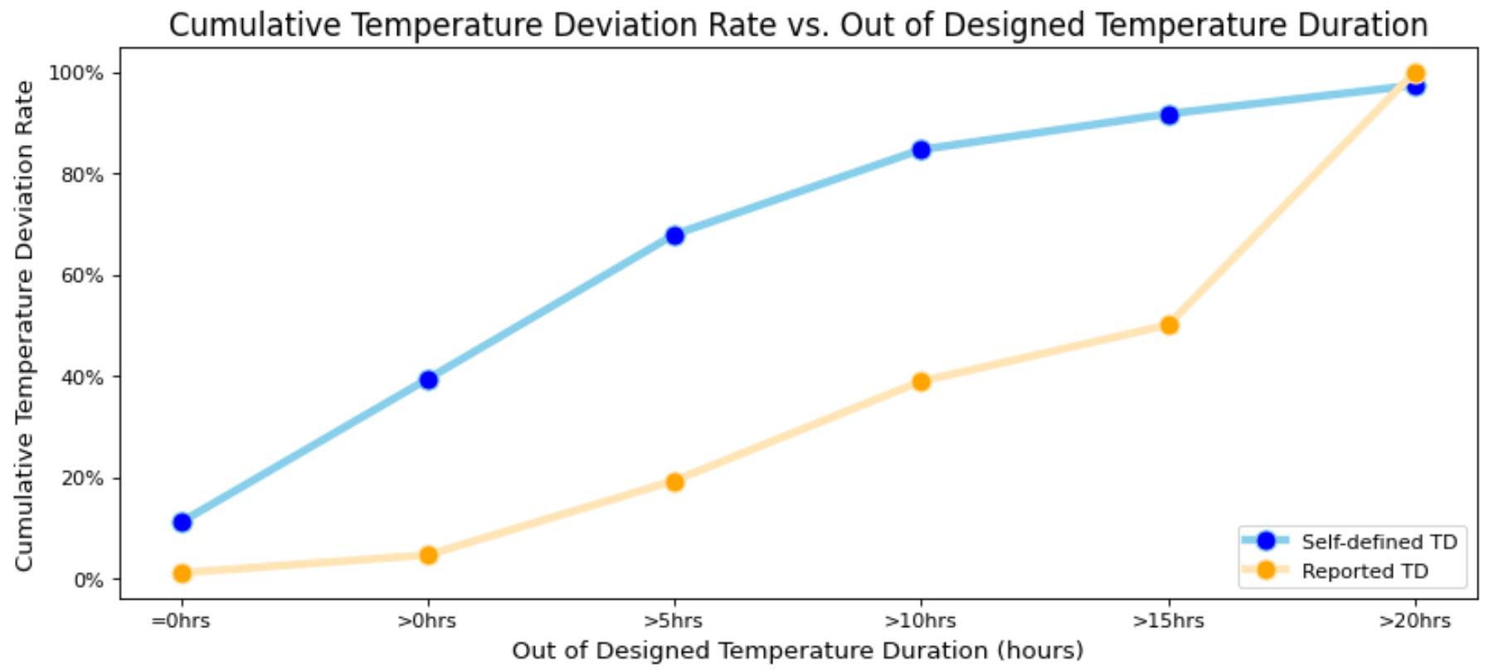
Temperature Deviation Findings
Out of Designed Temperature Duration vs. Temperature Deviation
When the ODTD increases from 0 hour to 10 hours, the cumulative temperature deviation rate significantly increases from 0.11 to 0.87.
31

Slide 33
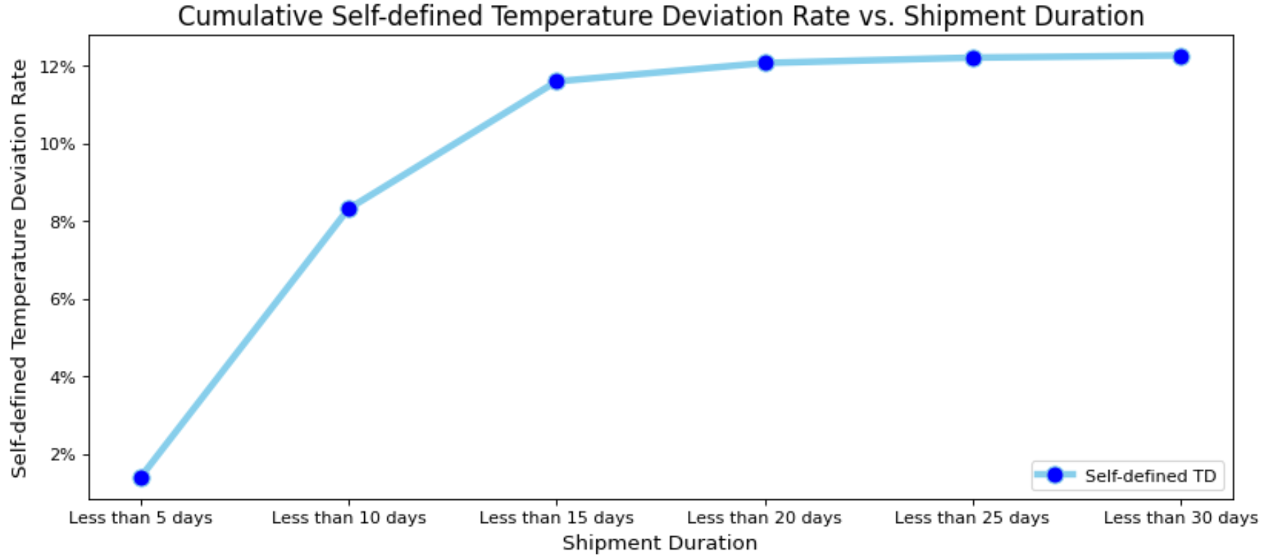
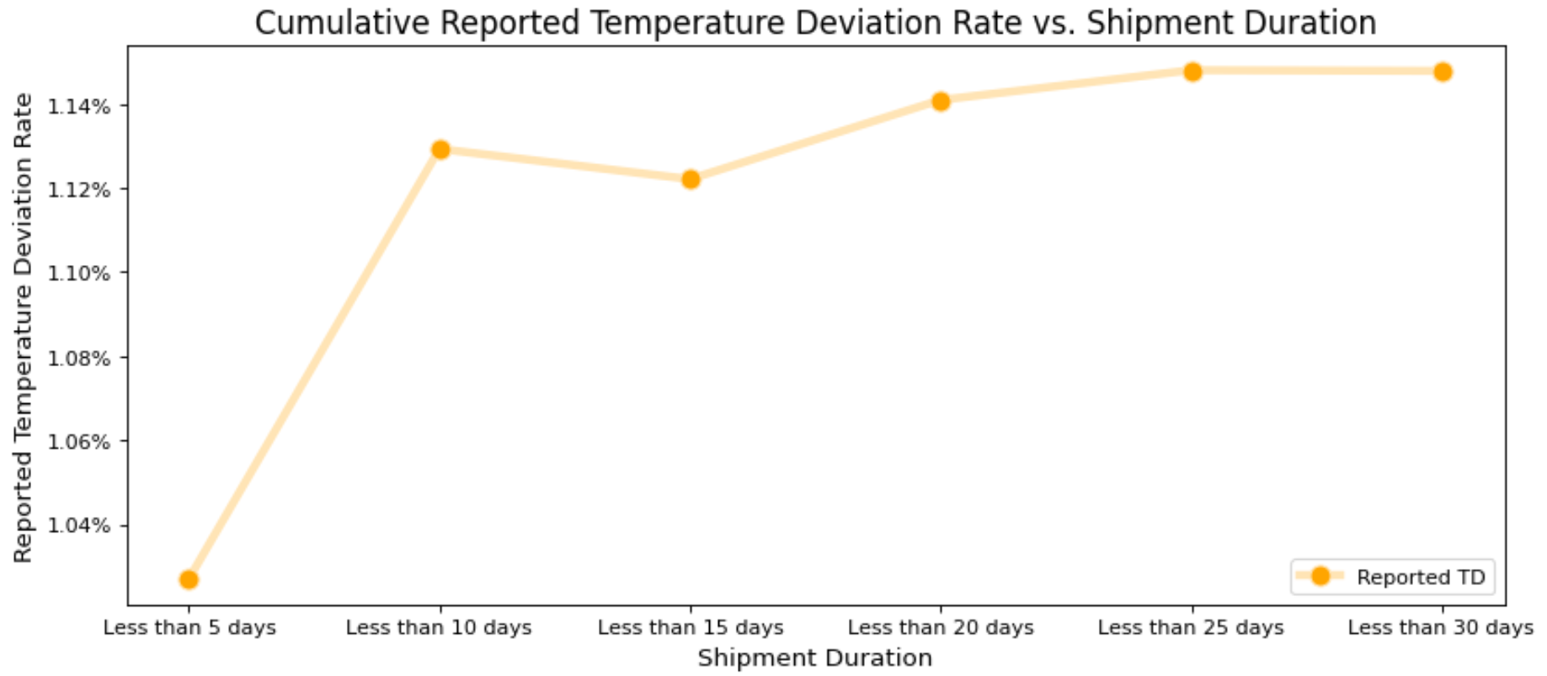
Temperature Deviation Findings
Shipment Duration vs. Temperature Deviation
Temperature deviation rate increases from 0.01 to 0.08 when the shipment duration changes from less than 5 days to less than 10 days
32

Slide 34
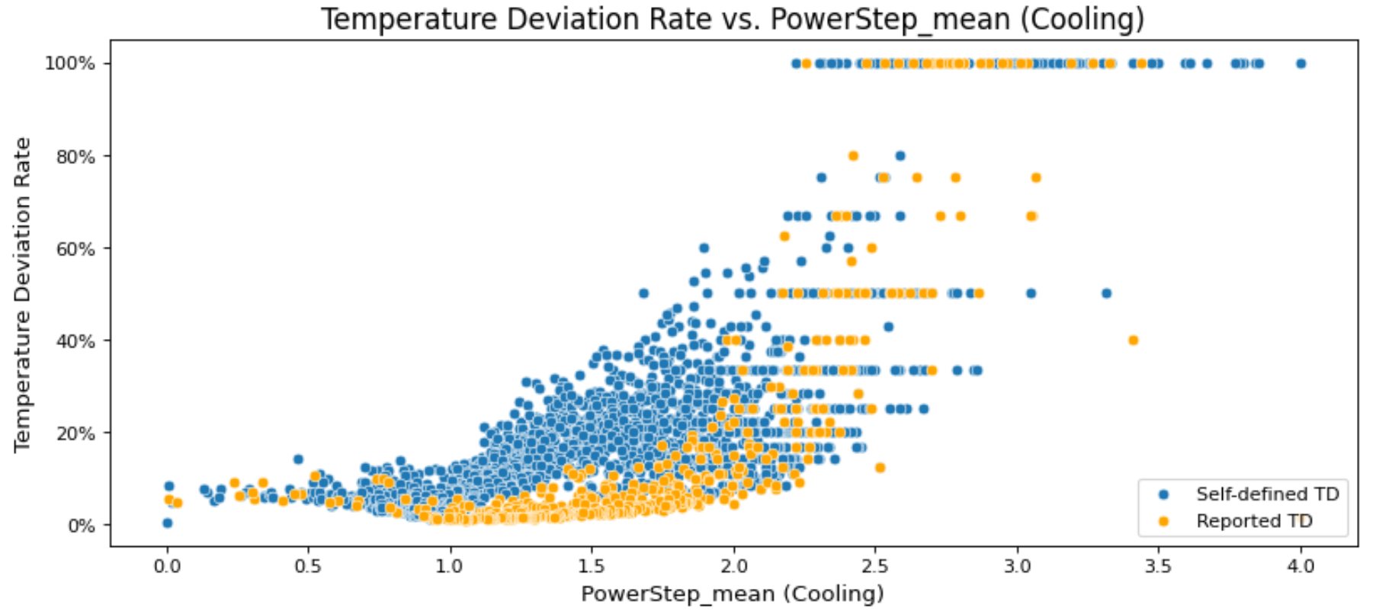
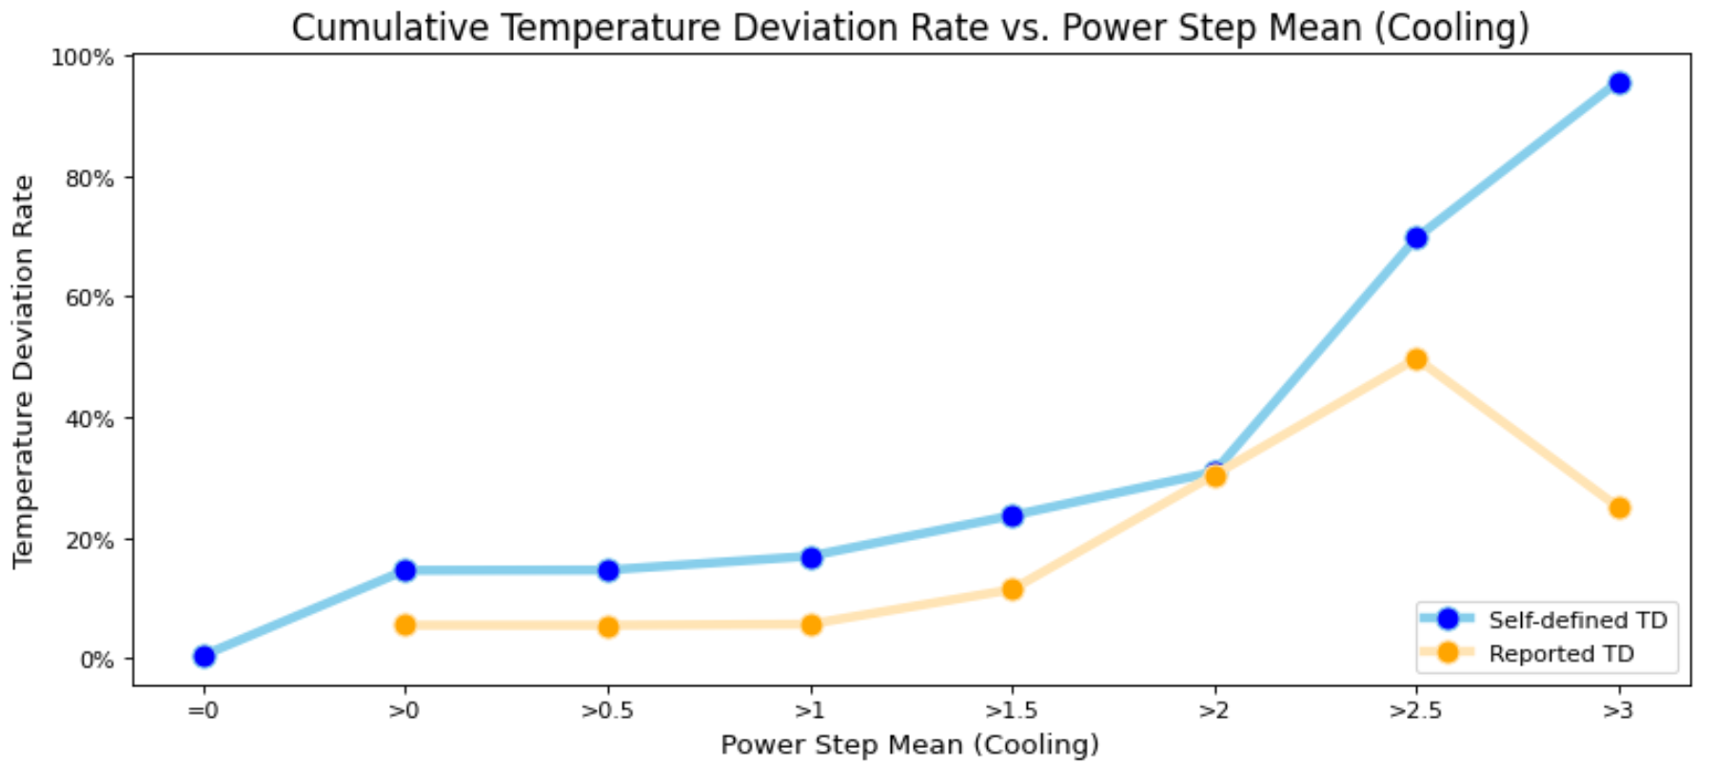
Temperature Deviation Findings
Compressor Power Step vs. Temperature Deviation
Containers experience higher temperature deviation rate when power step used for compressor (workload) increase
The reported temperature deviation rate demonstrates a very similar trend as its self-defined counterpart when plotted against mean compressor power step.
33

Slide 35
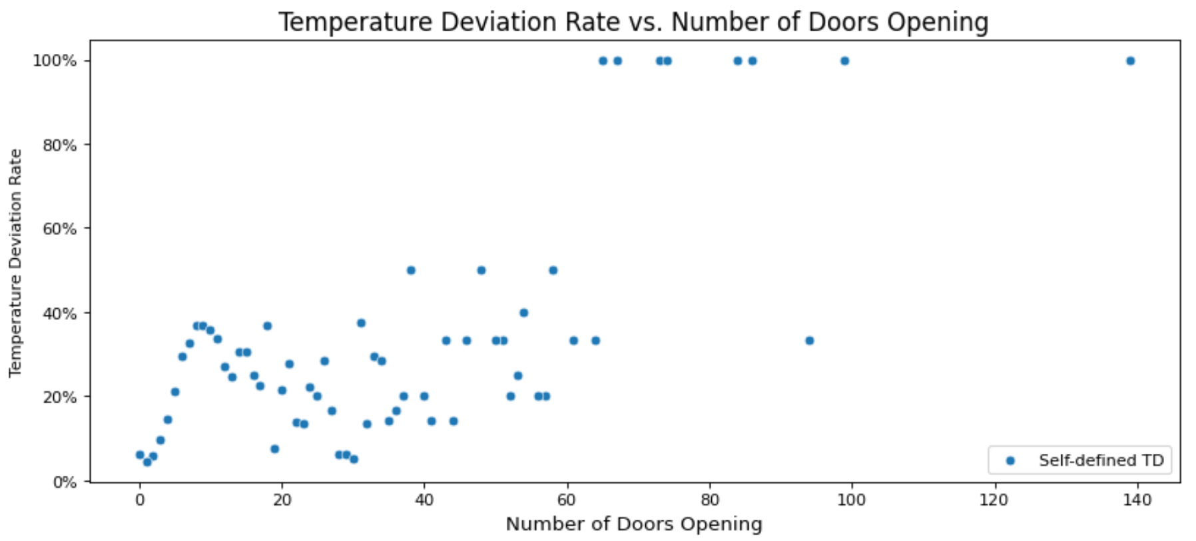
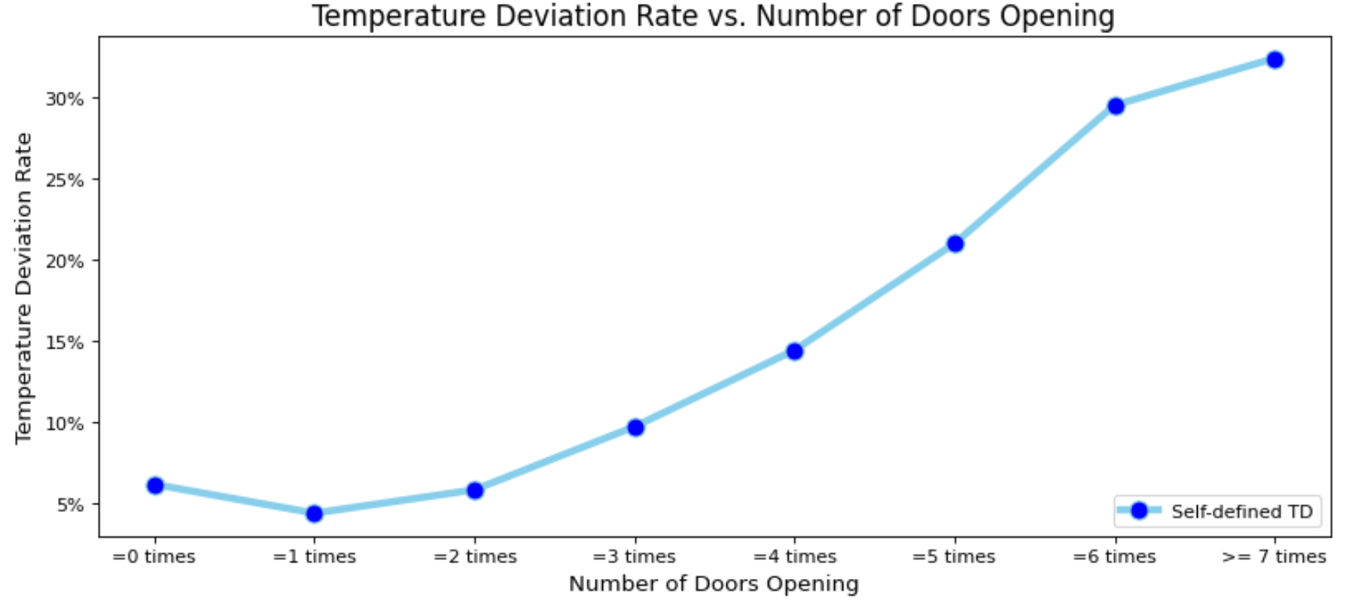
Temperature Deviation Findings
Number of Door Openings vs. Temperature Deviation
The number of door openings between 0 to 7 times, the temperature deviation rate increases from 0.06 to 0.32
The temperature deviation rate climbs significantly when the number of door openings is above 3 times during a shipment.
34

Slide 36
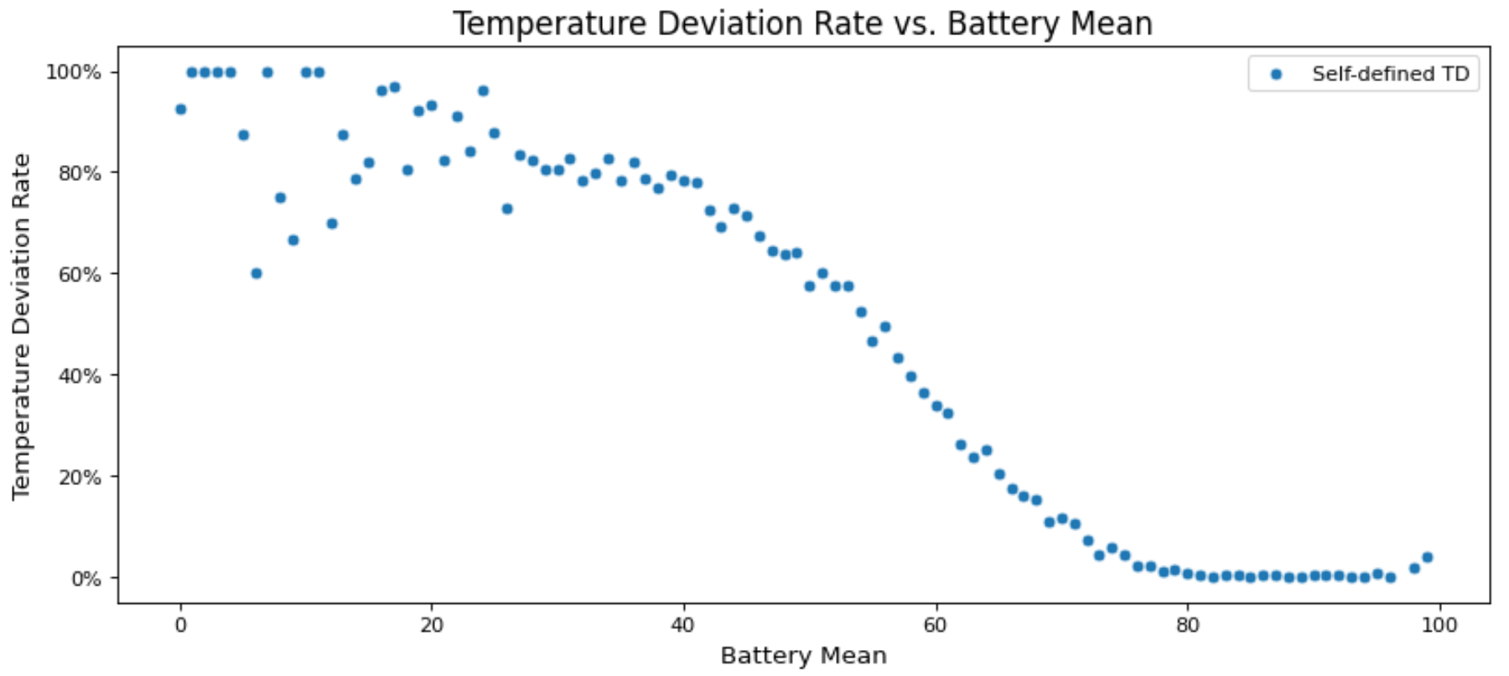
Temperature Deviation Findings
Battery Mean vs. Temperature Deviation
The non-temperature deviation shipments’ battery mean is 83.82%, and temperature deviated shipments’ battery mean is 46.19%
Temperature deviation rate decreases as the battery mean increases
35

Slide 37
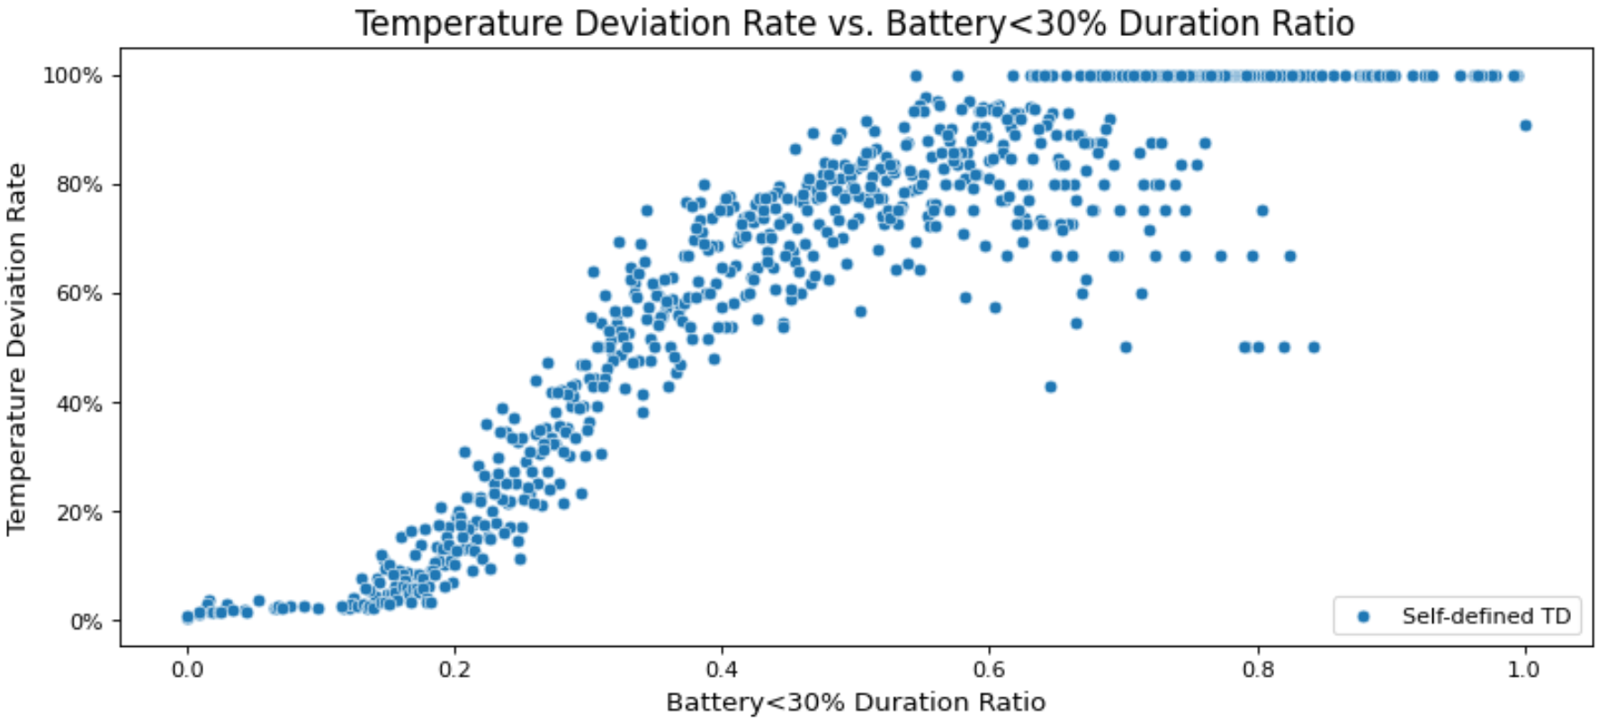
Temperature Deviation Findings
Battery < 30% vs. Temperature Deviation
As the duration ratio of battery less than 30% increases, the temperature deviation rate will also increase
It is suggested not to keep the container battery less than 30%.
36

Slide 38
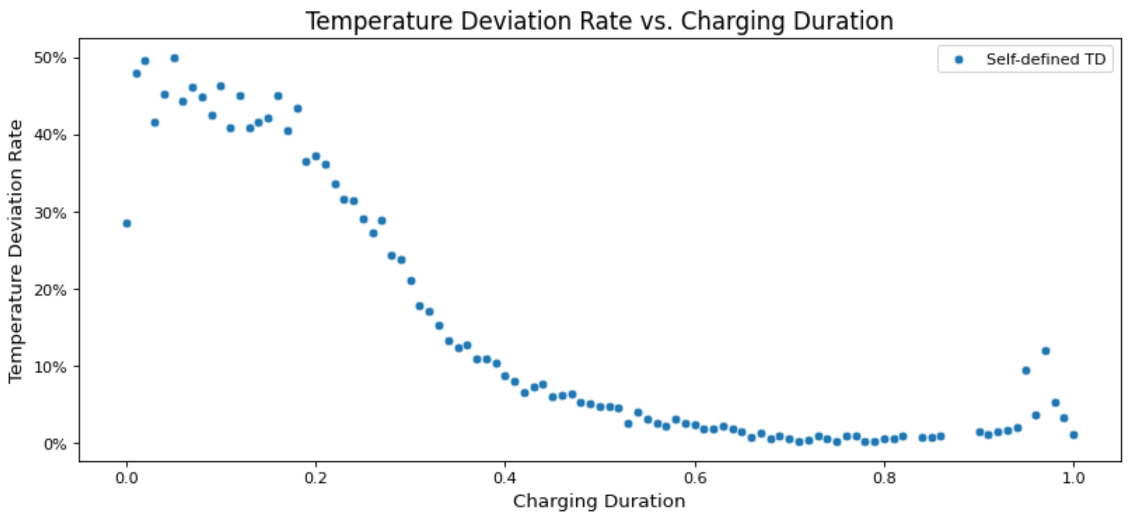
Temperature Deviation Findings
Charging Duration vs. Cumulative Temperature Deviation Rate
The longer we charge containers during a shipment, the lower temperature deviation rate will be
37

Slide 39
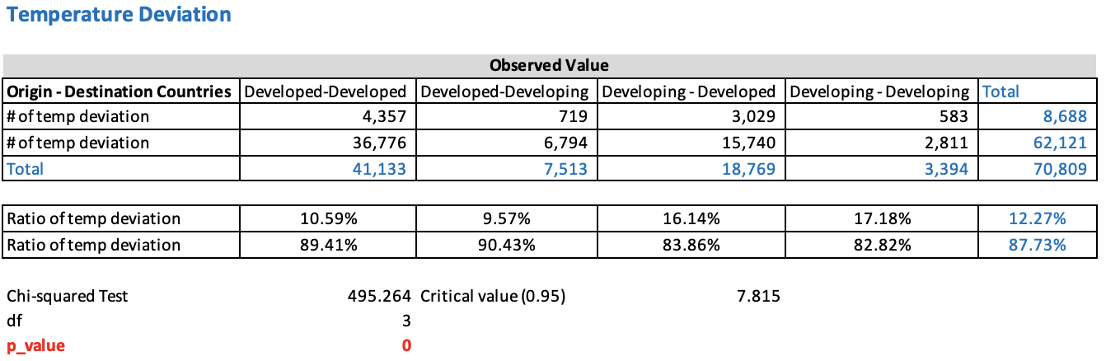
Temperature Deviation Findings
Economic Status vs. Temperature Deviation
Economic status of origin countries has a higher impact on temperature deviation ratio as the airline that handles the shipment tend to come from the origin country
Developed country airlines tend to handle containers better and produce smaller TD ratios
38

Slide 40
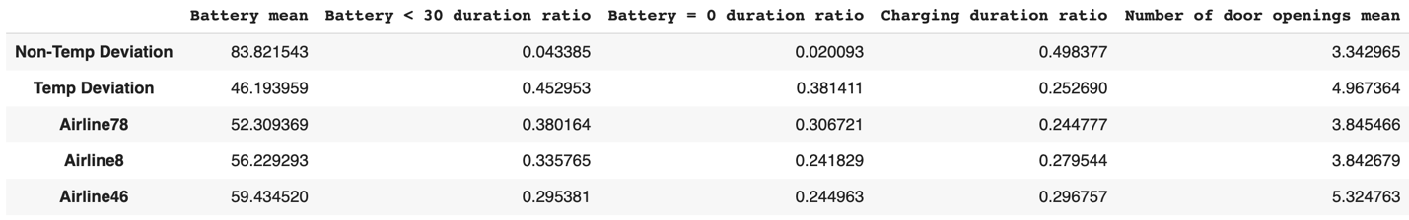
Airlines with High Temperature Deviation Rate
Top 3 Airline vs. Container Handling Behaviors
The top 3 temperature deviation rate airlines have a lower battery mean than non-temperature deviated shipments
The battery less than 30% and 0% duration are higher, while the charging duration rate is lower than non-temperature deviation shipments
The average number of door openings is higher for those airlines than the non-temperature deviation shipments.
39

Slide 41
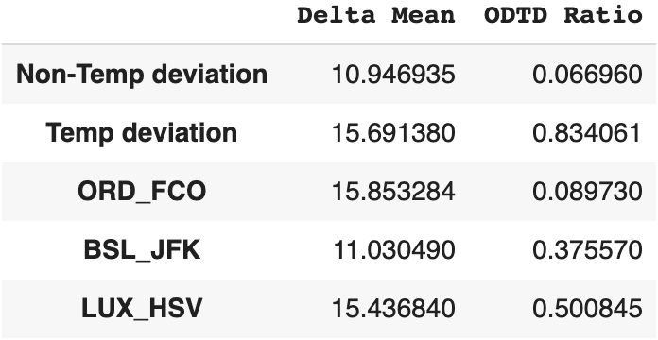
Trade Lanes with High Temperature Deviation Rate
Top 3 Trade Lanes vs. External Uncontrollable Factors
Shipment trade lanes with the highest temperature deviation rate tend to have a much larger average Delta than trade lanes with low temperature deviation rate
Containers in those high TD rate trade lanes experience much longer ODTD
40

Slide 42
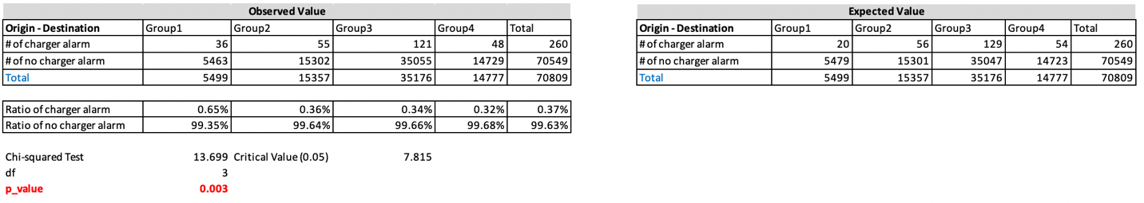
Failure Alarms Findings
Charger Alarms vs. Voltage
Voltage has an effect on the number of charger alarms
When the supply voltage of both origin and destination countries are between 100V and 127V, the charger alarm rate is the highest (0.65%)
When the supply voltage of both origin and destination countries are between 220V and 240V, the charger alarm rate is the lowest (0.32%)
The container chargers are twice as likely to failure when the supply voltage is between 100V-127V
41

Slide 43
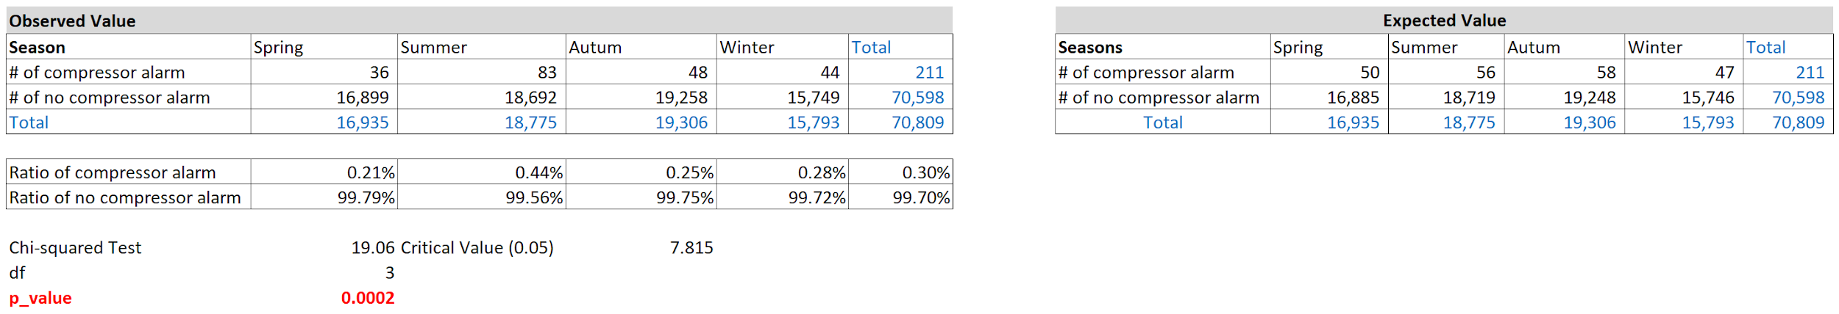
Failure Alarms Findings
Compressor Alarms vs. Season
In the Chi-squared test, we have observed a statistically significant seasonal effect on the compressor alarm rate
Containers experience more compressor alarms in summer than other seasons
There is a significantly higher compressor alarm rate of 0.44% in the summer
42

Slide 44
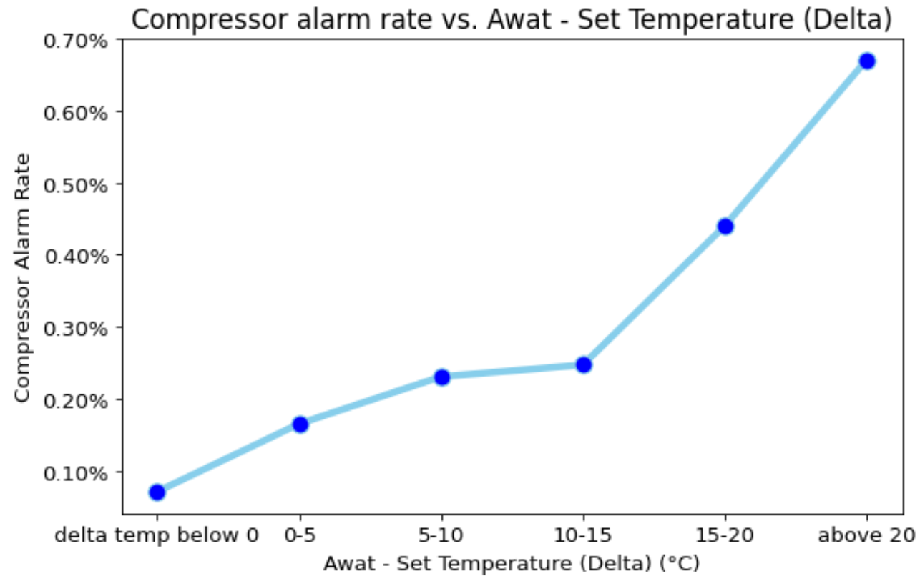
Failure Alarms Findings
Compressor Alarms Rate vs. Delta Temperature
Compressor alarm rate goes up as the delta temperature climbs. Especially after the temperature reaches above 15°C, the compressor alarm rate climbs quickly.
43

Slide 45
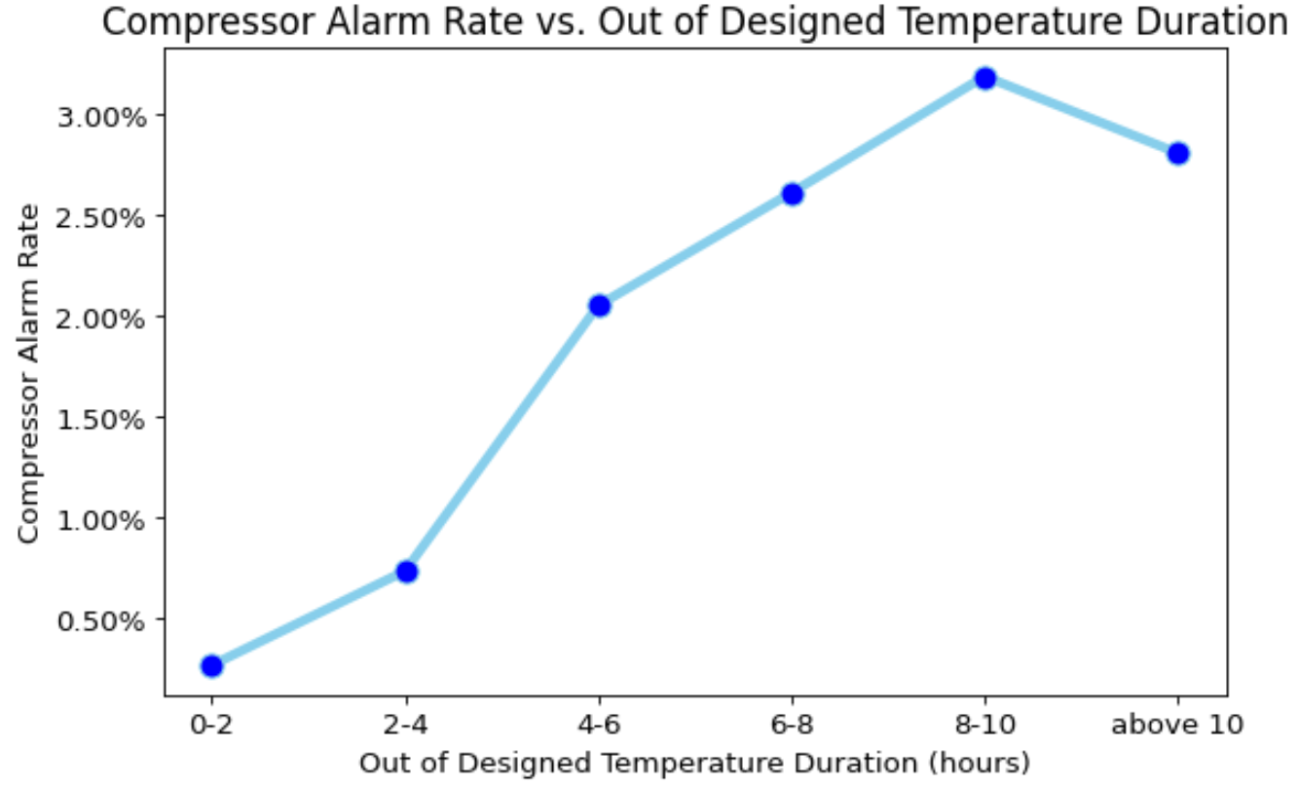
Failure Alarms Findings
Compressor Alarms Rate vs. Out of Designed Temperature Duration
It seems that after total 4 hours of experiencing out of designed temperature, there is a big jump in the compressor alarm rate
44

Slide 46
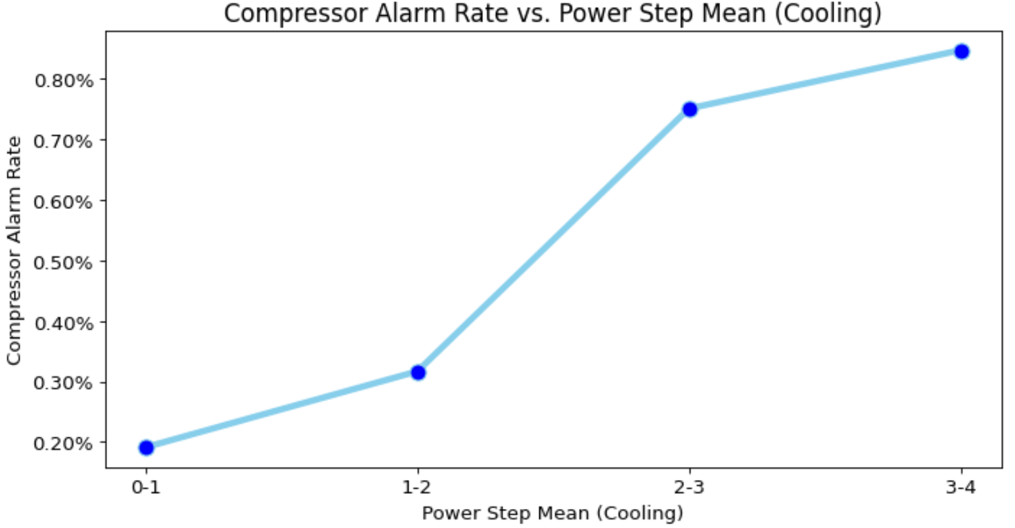
Failure Alarms Findings
Compressor Alarms Rate vs. Power Step Mean (Cooling)
A critical value of power step mean of 2, after which there is a big jump in the compressor alarm rate, is observed
45

Slide 47
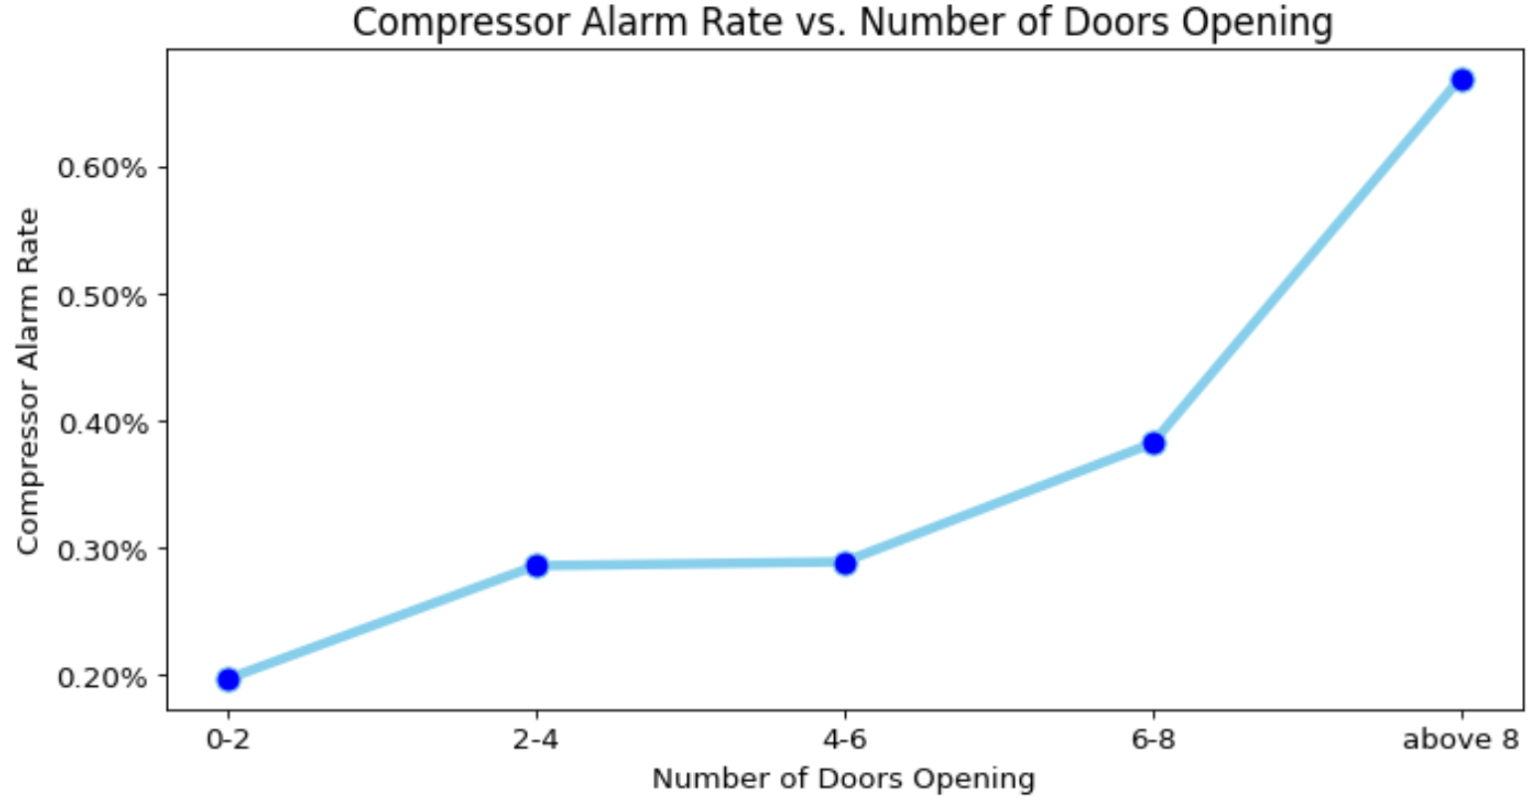
Failure Alarms Findings
Compressor Alarms Rate vs. Power Step Mean (Cooling)
Especially after the number of door openings reaches 6 time or more, there is a big jump in the compressor alarm rate
46

Slide 48
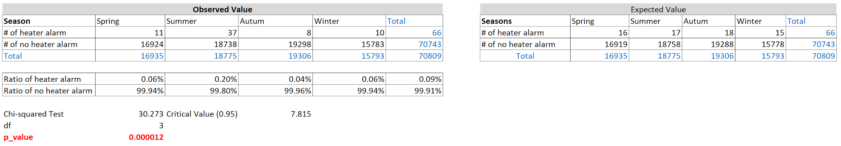
Failure Alarms Findings
Heater Alarms vs. Season
Heater alarms are more likely to occur in summer
There is a significantly higher heater alarm rate of 0.2% in the summer.
47

Slide 49
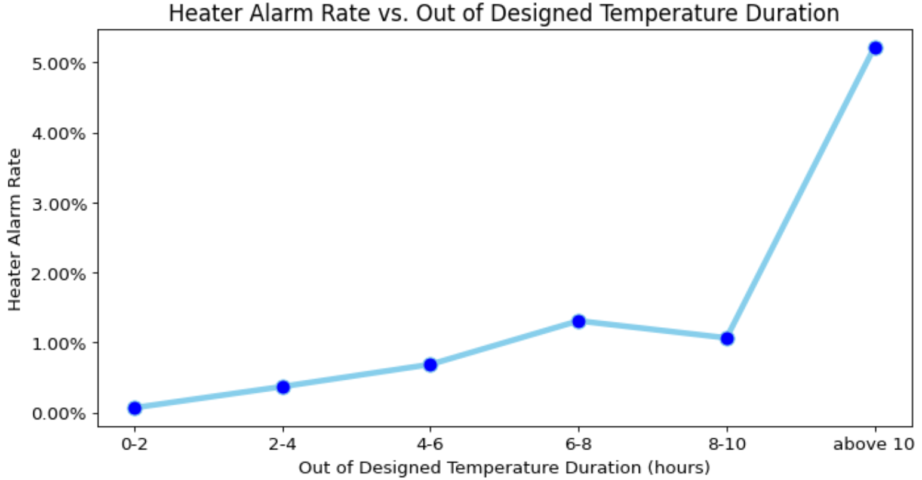
Failure Alarms Findings
Heater Alarms vs. ODTD
It seems that after total 10 hours of experiencing out of designed temperature, there is a big jump in the heater alarm rate
48

Slide 50
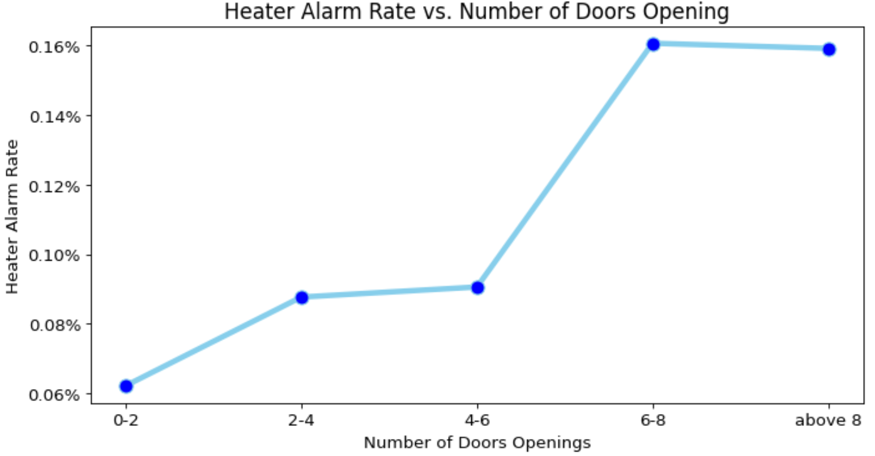
Failure Alarms Findings
Heater Alarms vs. Number of Door Openings
As the number of door openings increases, the heater alarm rate tends to climb, and when the number of door openings pass 4, there is big jump of the heater alarm rate
49

Slide 51
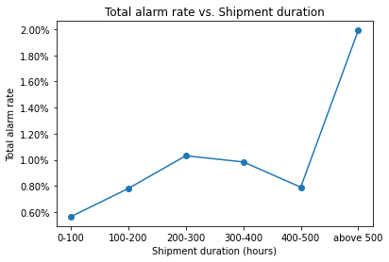
Failure Alarms Findings
Total Failure Alarms vs. Shipment Duration
The longer the shipment duration is, the higher the compressor total alarm rate is especially after the shipment duration is above 500 hours.
50

Slide 52
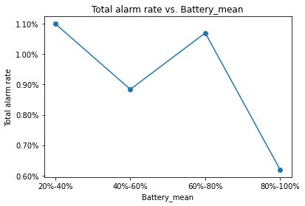
Failure Alarms Findings
Total Failure Alarms vs. Battery Level
Total alarm rate tends decreases as the battery increases
Maintaining a high battery level throughout the shipments can help to decrease total parts failure alarms rate
51

Slide 53
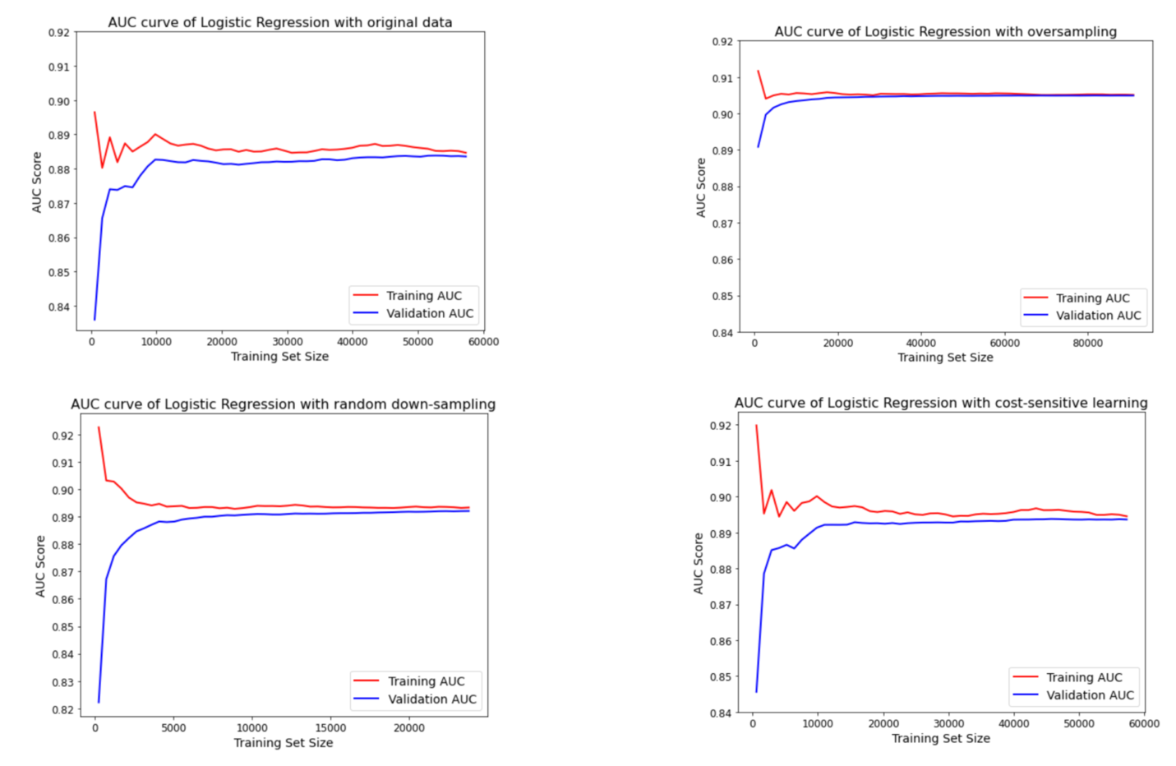
Predictive Model Findings
Training and Validation AUC Score Progression of Logistic Regressions
52

Slide 54
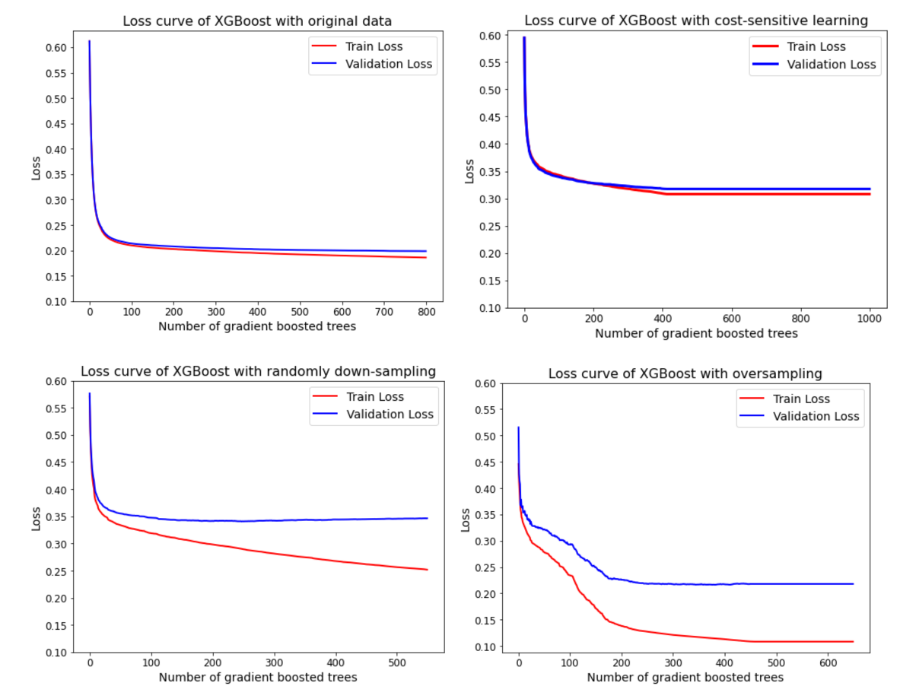
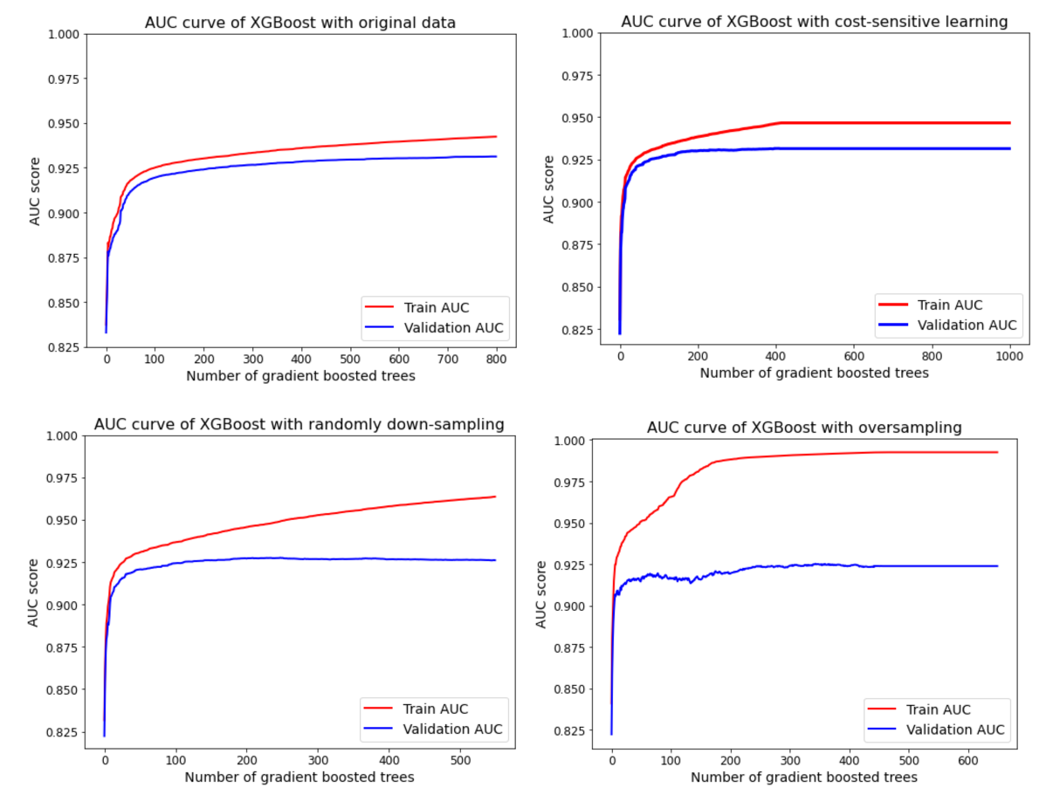
Predictive Model Findings
Training and Validation Loss and AUC Score Progression of XGBoost
53

Slide 55
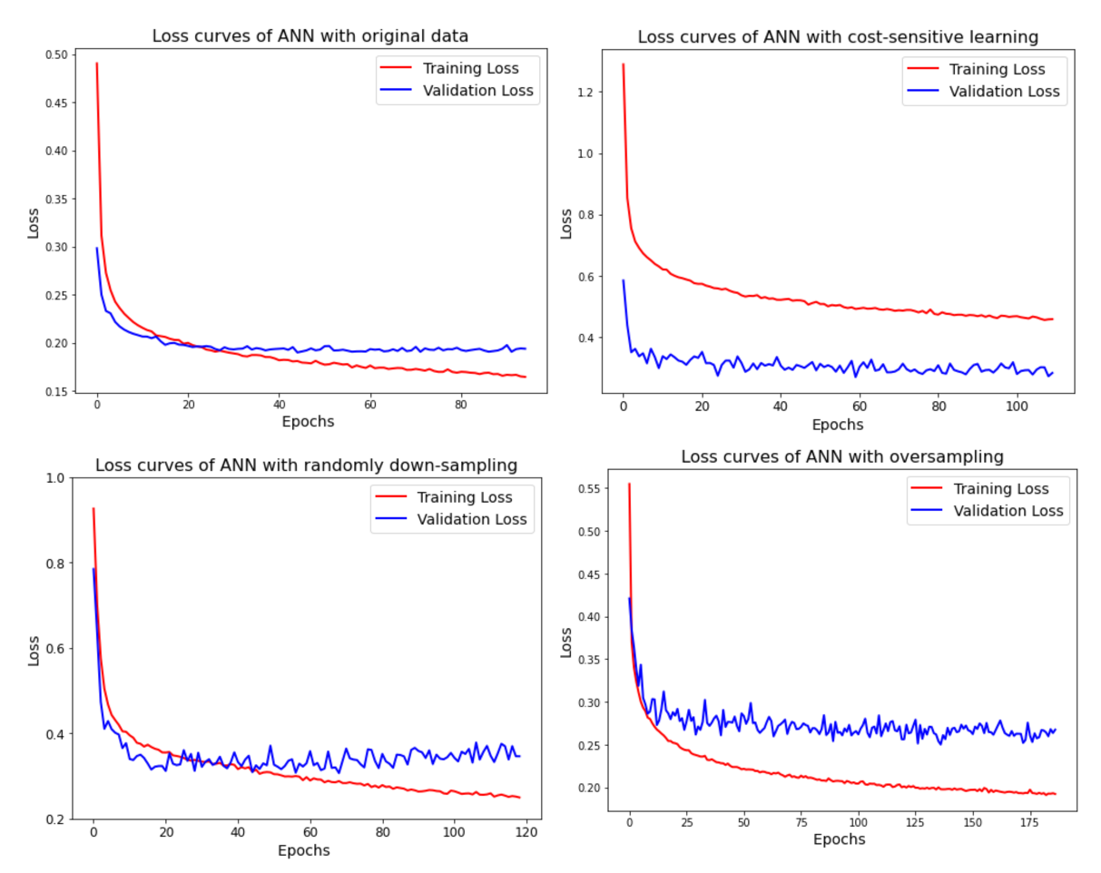
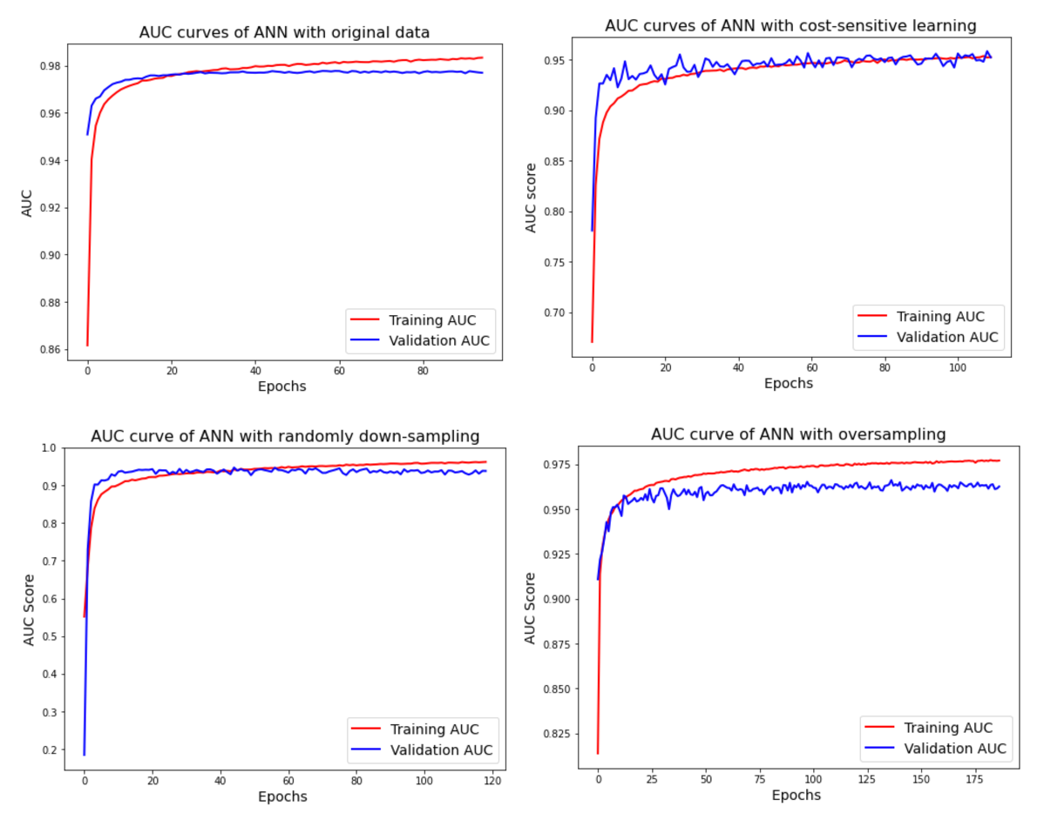
Predictive Model Findings
Training and Validation Loss and AUC Score Progression of ANN
54

